Slide 1

Problem Statement 1:Sustainable Port Infrastructure Development for Large-Scale EPC Projects in India
Team Name :MANIT-pop
Institute Name: Maulana Azad National Institute of Technology, Bhopal
Team Leader’s Name & Contact Details: Manasvi Sakhala, +919579235093
Sensitivity : This Document is Classified as "LNT Internal Use".

Slide 2



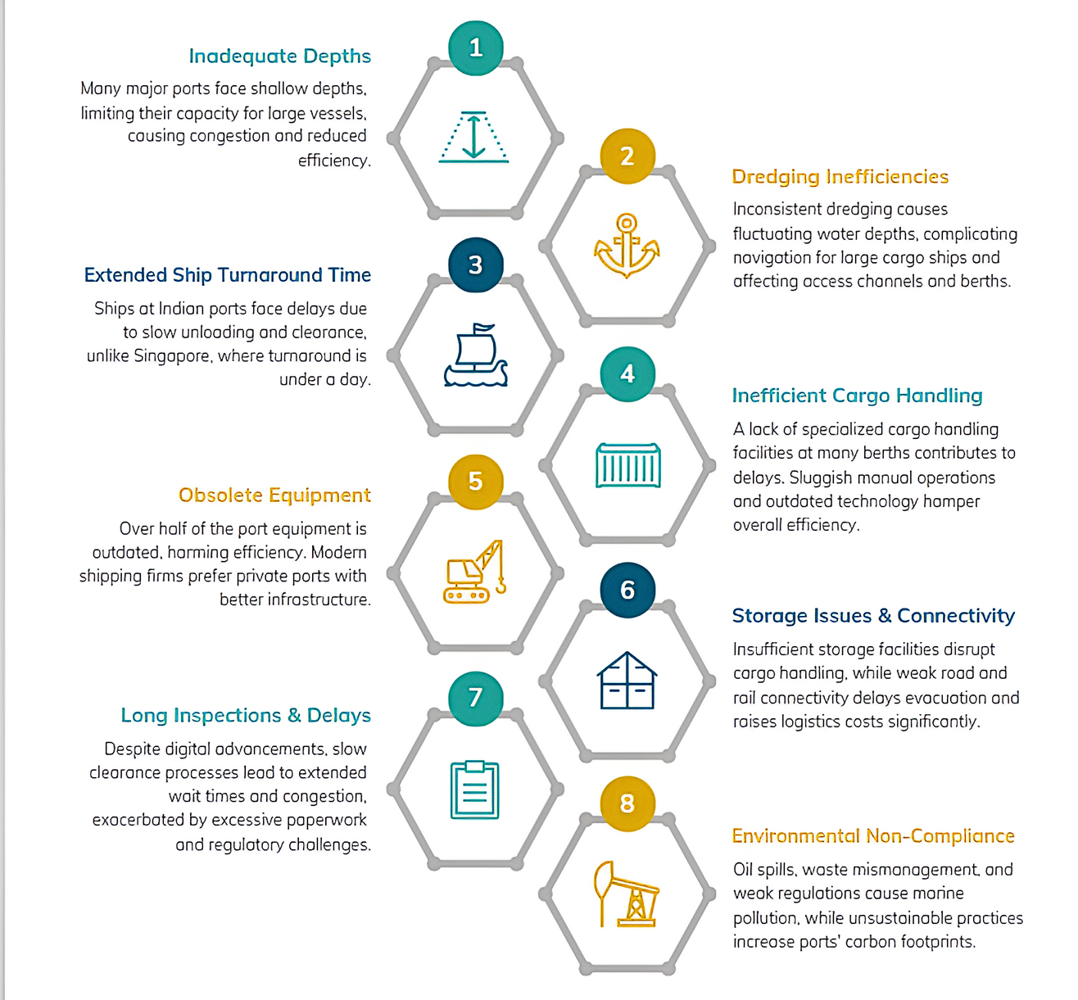

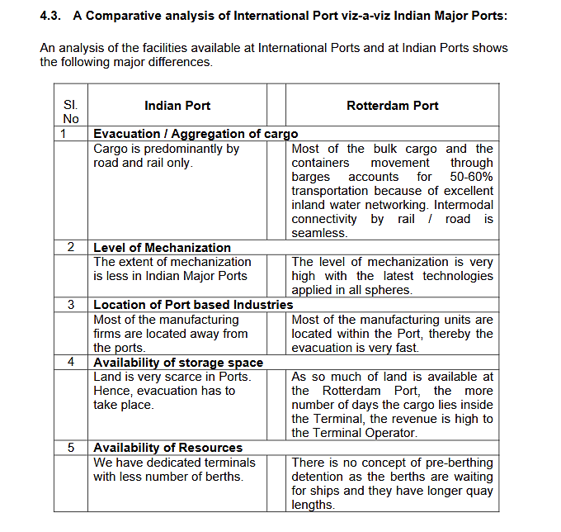
CHALLENGES FACED BY INDIAN PORTS
EDI (Electronic Data Interchange) implementation in Indian ports is partial, with manual processes, while Rotterdam has a fully digital system with minimal human intervention. Customs clearance in India happens at the port, whereas in the EU, it can be done elsewhere. Work processes in India are partly computerized, whereas Rotterdam uses enterprise resource planning (ERP) software, etc.
Sensitivity : This Document is Classified as "LNT Internal Use".
"Port Operations Report," Ministry of Shipping, Road Transport and Highways, Government of India, March 20, 2007, pp. 16-17.

Slide 3
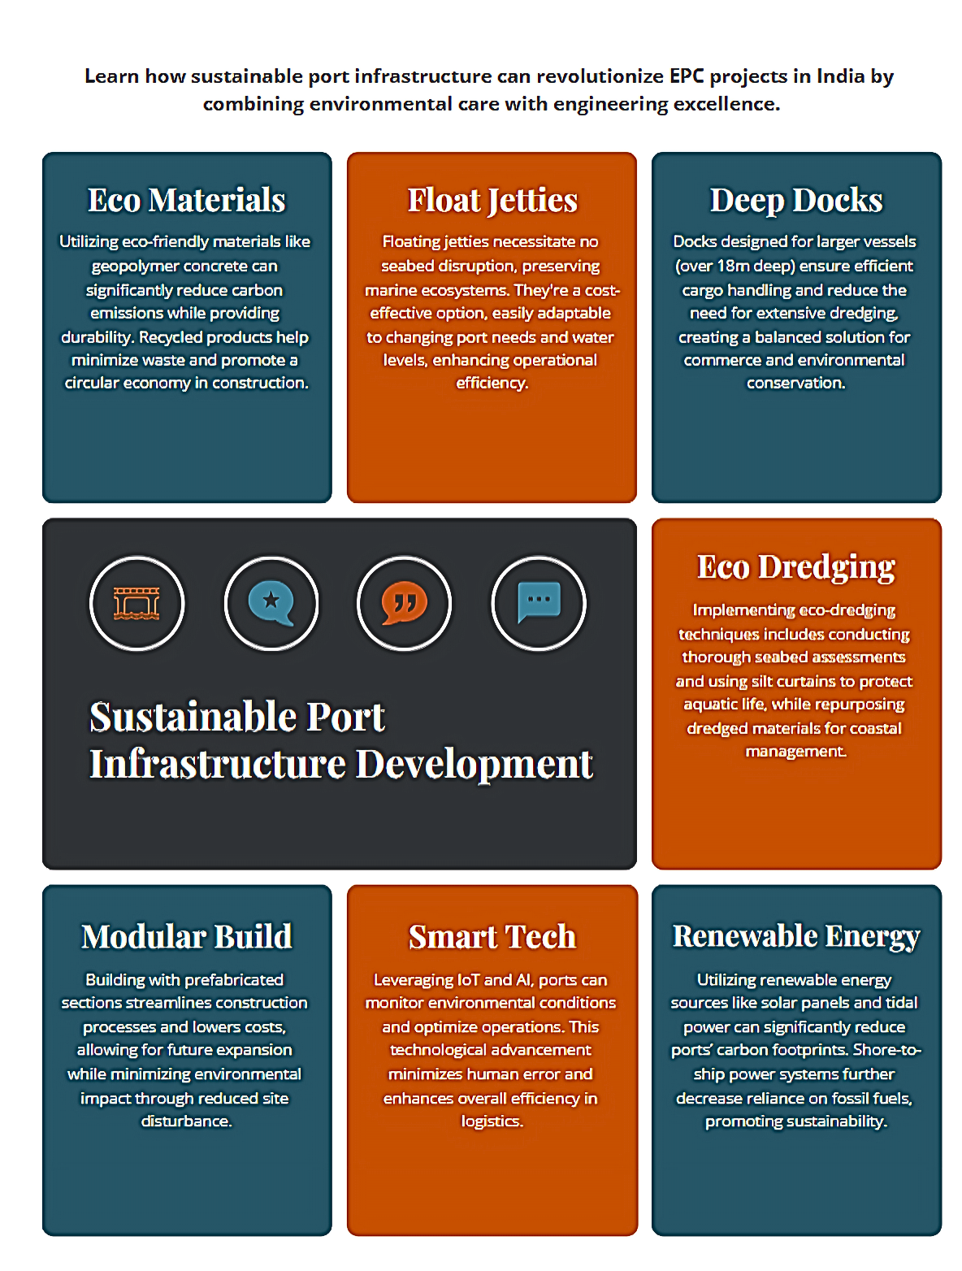
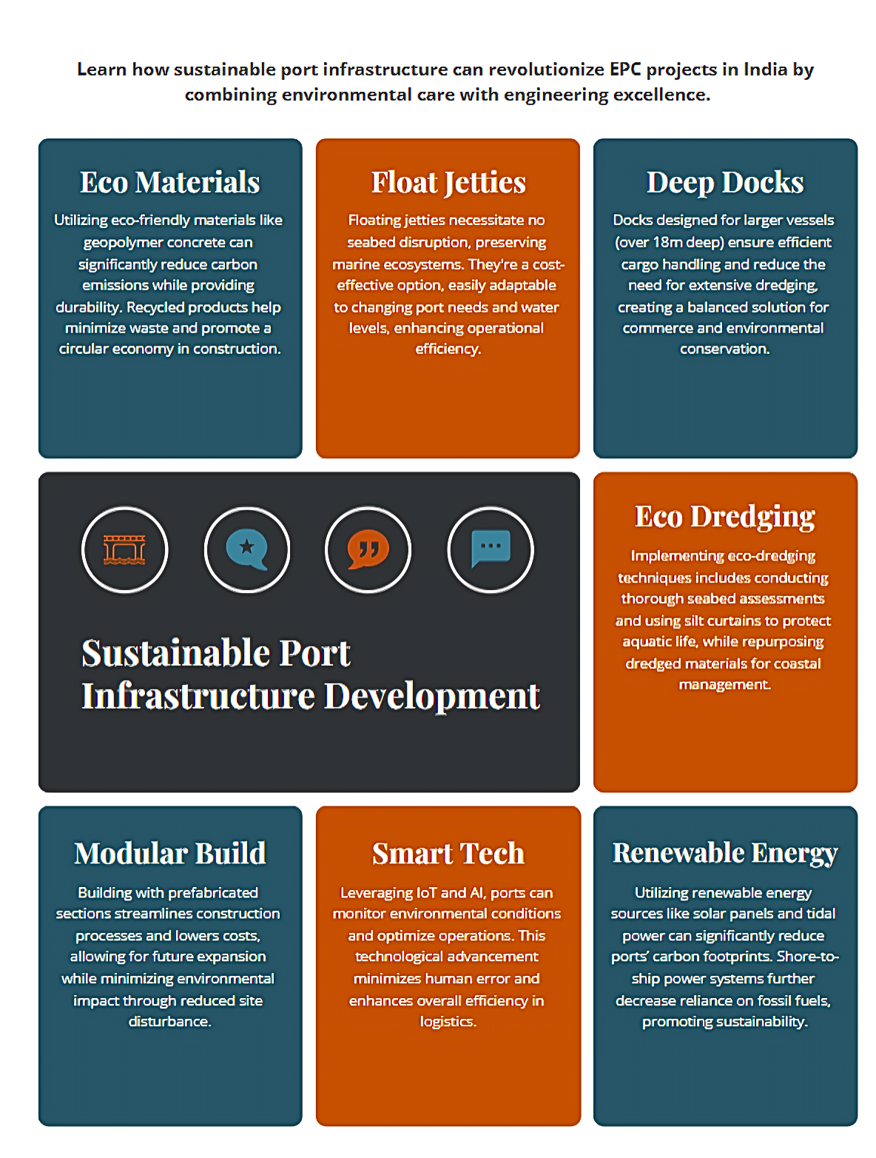
OUR PROPOSED SOLUTION
Key Solutions:
Eco Materials – Uses sustainable materials like geopolymer concrete and recycled products to cut carbon emissions while ensuring durability.
Float Jetties – No seabed disruption, cost-effective, and adaptable to changing water levels, ensuring smooth port operations.
Deep Docks – Designed for large vessels (18m+ deep) to handle cargo efficiently while reducing dredging needs, benefiting both commerce and marine life.
Eco Dredging – Conducting seabed surveys, using silt curtains to protect aquatic life, and repurposing dredged materials for coastal management.
Modular Build – Prefabricated sections streamline construction, lower costs, allow expansion, and minimize environmental impact.
Smart Tech – Using IoT & AI for environmental monitoring, reducing human errors, and optimizing logistics.
Renewable Energy – Solar panels, tidal power, and shore-to-ship electricity reduce ports' carbon footprint and reliance on fossil fuels.
Sensitivity : This Document is Classified as "LNT Internal Use".

Slide 4
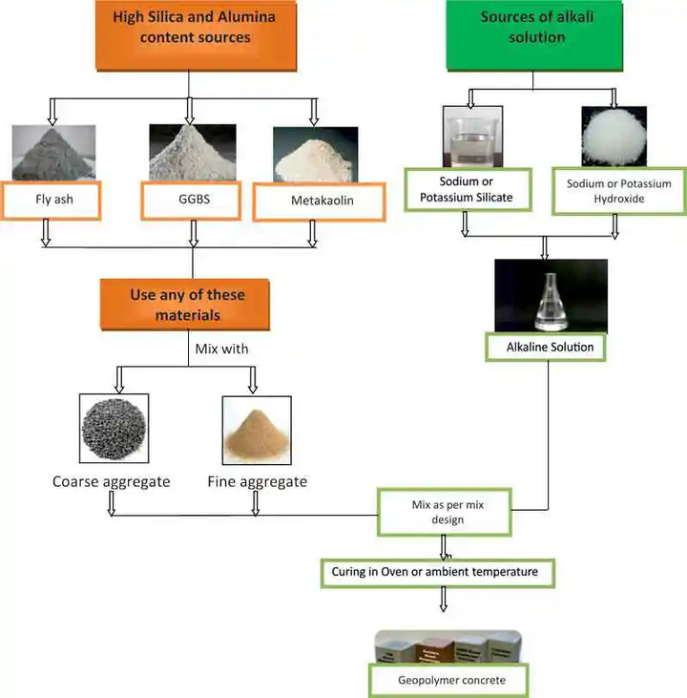
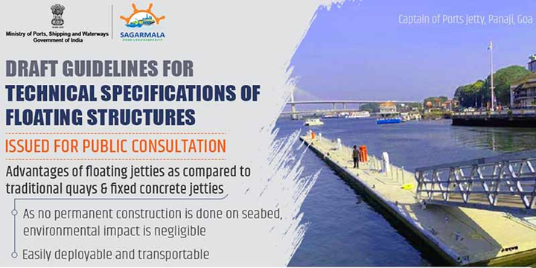
Eco-Friendly Construction & Materials – A Smarter, Greener Choice
Traditional port construction is carbon-intensive and environmentally damaging. Our sustainable approach ensures durability, lower emissions, and long-term cost savings.
Geopolymer Concrete (GPC): Reduces CO₂ emissions by 50-80%, highly durable, and resistant to marine corrosion.
Recycled Materials: Crushed concrete, rubber, and plastic reduce waste while strengthening foundations.
Sustainable Steel & Bamboo: Low-carbon, high-strength, and earthquake-resistant construction materials.
Eco-Friendly Coatings: Graphene-based protection extends infrastructure life and reduces maintenance costs.
Floating Jetties – Smart, Sustainable, and Cost-Effective
Why Choose Floating Jetties?
No seabed excavation, preserving marine ecosystems
Cost-effective and adaptable to port needs
Expandable, relocatable, and wave-resistant
Key Design Requirements
Structure: 20+ years lifespan, withstands 0.6m waves, stable under heavy loads
Materials: M45 concrete, GGBS cement (eco-friendly), EPS floatation cores, corrosion-resistant steel
Mooring: Pile mooring for calm waters, chain mooring for rough conditions
Sensitivity : This Document is Classified as "LNT Internal Use".

Slide 5


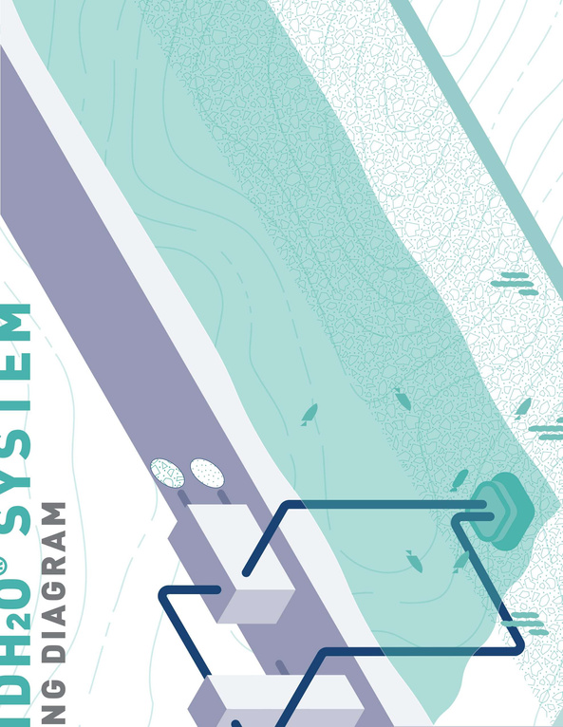


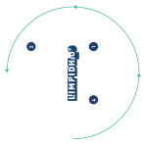




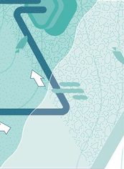
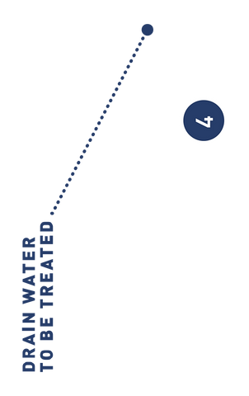

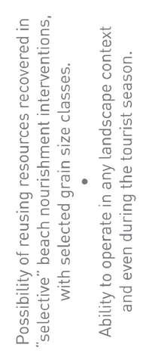

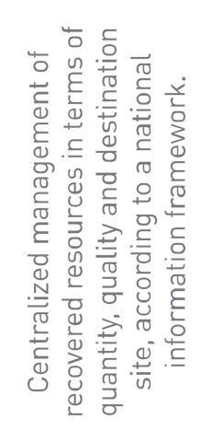
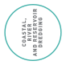
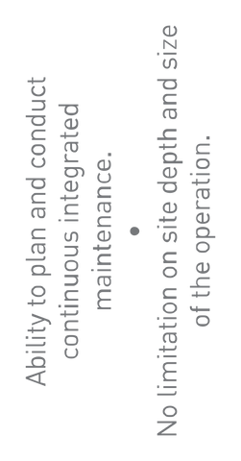
Eco-Dredging: Sustainable Depth Management
Key Components:
Sustainable Dredging Practices – Uses hydrographic surveys, geotechnical investigations, and environmental assessments to plan dredging with minimal disruption.
Beneficial Use of Dredged Material – Reused for land reclamation, beach nourishment, habitat restoration, and construction materials to reduce waste.
Low-Impact Dredging Techniques – Includes closed bucket dredging, hydraulic and mechanical dredging for minimal seabed disturbance.
Sediment Control & Recycling – Uses capping, bioremediation, and sediment recycling to prevent contamination spread.
Advanced Monitoring & Modeling – Real-time water quality tracking, USVs, and mathematical modeling optimize dredging efficiency and reduce ecological impact.
PPP Model & Cost Optimization – Encourages Public-Private Partnerships for cost-effective, efficient execution with strict quality control and monitoring.
Inspired by Fincantieri’s LIMPIDH2O® system, we aim to implement eco-friendly dredging solutions that minimize environmental impact, optimize sediment reuse, and reduce operational costs. This closed-loop, non-invasive technology aligns with global sustainability goals, ensuring regulatory compliance and long-term efficiency in our sustainable seaport development.
Sensitivity : This Document is Classified as "LNT Internal Use".

Slide 6
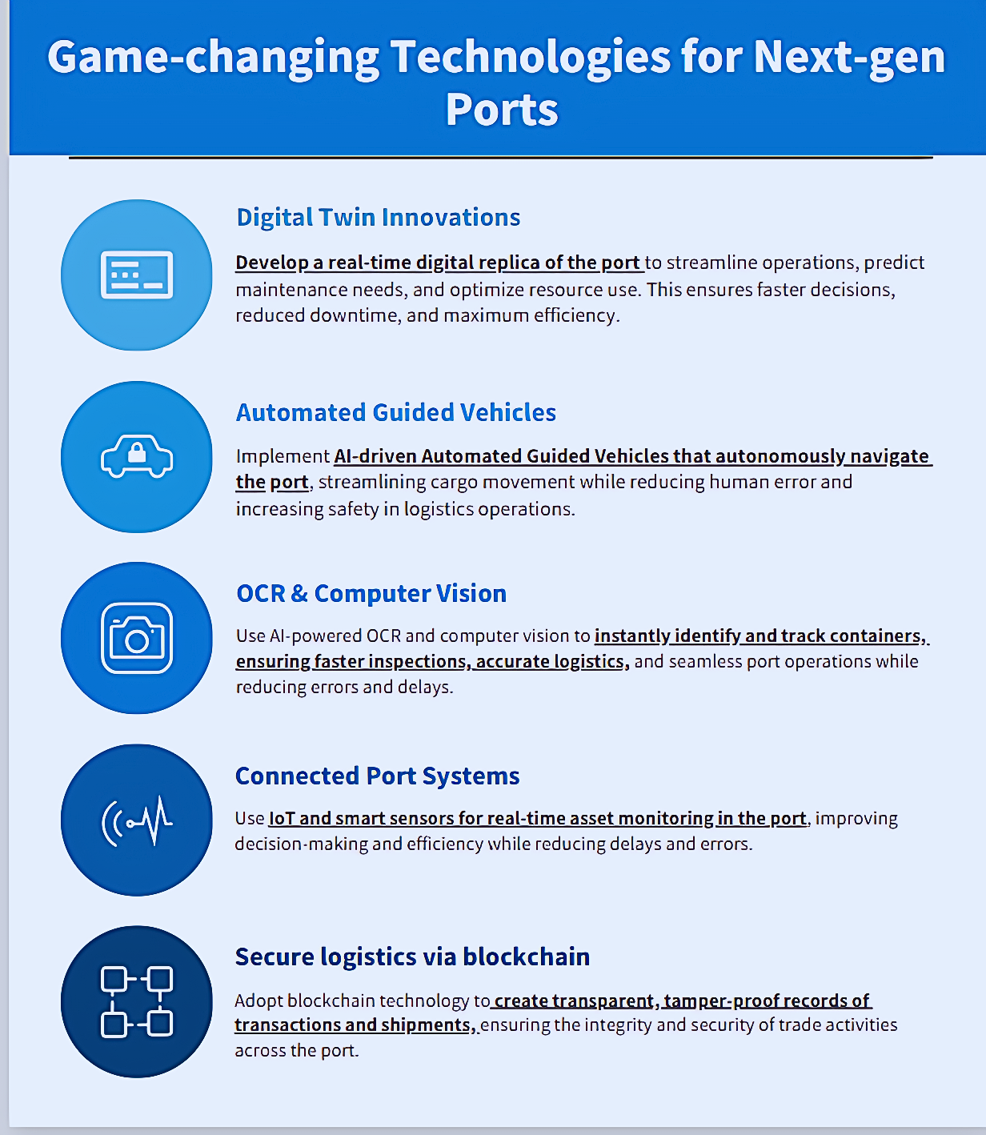
Why Do Ports Need Automation?
Faster Cargo Handling – AI-driven systems cut turnaround time, reducing congestion and delays.
Cost Optimization – Robotics minimize labor and operational costs while boosting efficiency.
Zero Delays, Zero Errors – AI and IoT-powered logistics ensure seamless, error-free operations.
Sustainability & Green Ports – Energy-efficient solutions lower emissions for eco-friendly operations.
Game-Changing Technologies for Next-Gen Ports
Sensitivity : This Document is Classified as "LNT Internal Use".

Slide 7
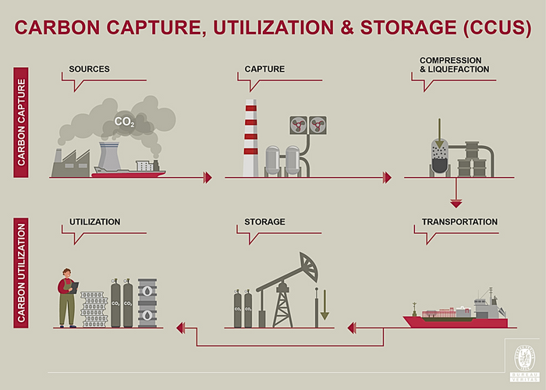
Shore Power
Key Components
Shore power, also known as cold ironing or alternative maritime power (AMP), is a system where docked ships connect to the local electricity grid instead of running their diesel engines. This helps in reducing fuel consumption, emissions, and noise pollution at ports.
Shore-Side Infrastructure
Ship-Side Infrastructure
Benefits of Shore Power in Ports
Reduces Carbon Emissions – Cuts SO₂, NOₓ, and CO₂ emissions from ships at berth.
Decreases Noise Pollution – Ships don’t run generators, reducing port noise.
Energy Cost Savings – Shore power is often cheaper than diesel fuel.
Regulatory Compliance – Helps ports meet IMO and environmental regulations.
Carbon Capture Solution
Flue Gas Collection – CO₂ is captured directly from ship exhaust gases.
Chemical Absorption – Amine-based solvents (MEA, DEA) absorb CO₂ from emissions.
Air Intake System – Large industrial fans capture ambient air for CO₂ extraction.
Chemical Adsorption – Solid sorbents (e.g., calcium looping, zeolites) trap CO₂ efficiently.
CO₂ Compression & Storage – Collected CO₂ is liquefied for transport or injected underground for long-term storage.
.
Sensitivity : This Document is Classified as "LNT Internal Use".

Slide 8
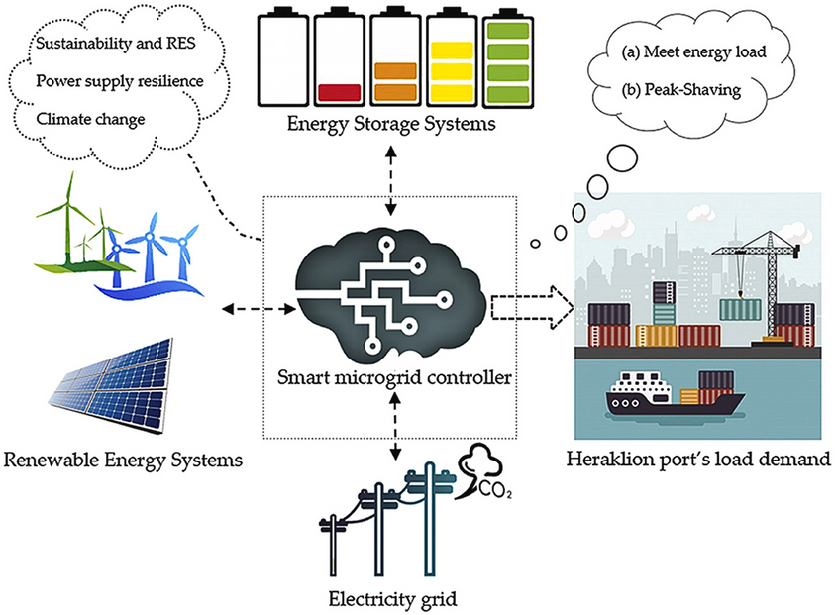
Renewable Energy and Smart System
Hybrid Renewable Energy – Integrating solar and wave energy ensures reliable power.
Battery Storage – Enhances renewable energy utilization by up to 15%.
Financial Viability – Payback in 2–6 years through incentives and energy savings.
Decentralized RECs – Multiple RECs are more cost-effective than a single large system.
To enhance port sustainability, key measures include expanding green cover, electrifying equipment, and adopting clean fuels like Green Hydrogen and Ammonia. Establishing renewable energy systems, LNG bunkering, and EV charging will further reduce carbon emissions. Efficient water and waste management, including 100% wastewater recycling and marine ecosystem protection, will minimize environmental impact. Real-time monitoring, annual audits, and carbon credit incentives will ensure compliance and continuous improvement, aligning with the Harit Sagar - Green Port Guidelines.
Sensitivity : This Document is Classified as "LNT Internal Use".

Slide 9
REFRENCES
.Hybrid renewable energy system optimum design and smart dispatch for nearly Zero Energy Ports
Inter-Ministerial Group. (2006). Dwell time and efficiency at ports (Report). Government of India.
Ministry of Ports, Shipping and Waterways. (2021). Dredging guidelines for major ports. Government of India.
Ministry of Ports, Shipping and Waterways. (2023). Harit Sagar - Green Port Guidelines (Rev-0). Government of India
Ministry of Ports, Shipping and Waterways. (n.d.). Guidelines for floating jetties/platforms for marinas, minor harbors, fishing harbors, fish landing centers, waterdromes, and similar facilities. Government of India.
Sensitivity : This Document is Classified as "LNT Internal Use".

